Slide 1
Lecture 10:
Environmental Rights and Justice
Course: Environment and Politics in India

Slide 2
Rights
        THEORIES of Rights:
        The Theory of Natural Rights: Right to remain in the ‘state of nature’, to act according to the ‘law of nature’. Absence of government/ORGANISED political authority.
        The UTILITARIAN theory of rights: Acting according to the theory that the ‘’community’ must achieve MAXIMUM’ utility.
        Very popular with policy-makers (Nehru and the Hirakud Dam)
        Assumes that UTILITY can be QUANTIFIED. By WHOM?
        Justifies the impoverishment of SOME members.
        John RAWLS on rights.
        LIBERTARIAN theory of rights: Emphasizes procedural justice, puts individuals rights (over property etc.) ABOVE ALL.

Slide 3
Rights
        HUMAN RIGHTS:
        WHAT are they? International MORAL and LEGAL norms. Applicable to the STATE.
        SECURITY rights: Against murder/rape/torture
        LIBERTY rights: Freedom of belief/expression/association
        POLITICAL rights: Right to participate in political activity/vote/serve in public office
        DUE PROCESS rights: Against illegal detention/punishment without trial
        EQUALITY rights: Equality under law, protection against discrimination
        WELFARE rights: Economic and Social rights (food/education/health etc.)
        GROUP rights: Protection against genocide, religious/ethnic discrimination.

Slide 4
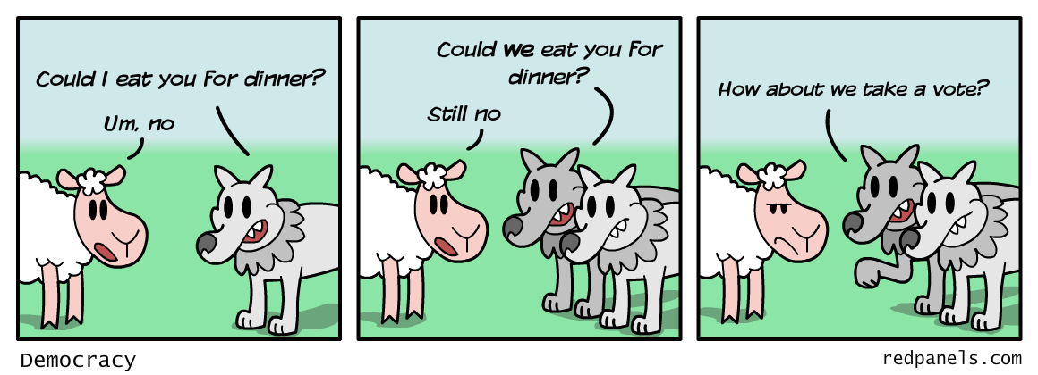
Rights
      MULTICULTURAL perspective on human rights:
  Differences in society need to be accommodated.
  Some groups are less advantaged in the CULTURAL/political sphere.
  GROUP-DIFFERENTIATED rights to preserve cultures: territorial autonomy, veto powers, guaranteed representation, land claims, language rights.
  LIMITATIONS: Assaults on democratic values.

Slide 5
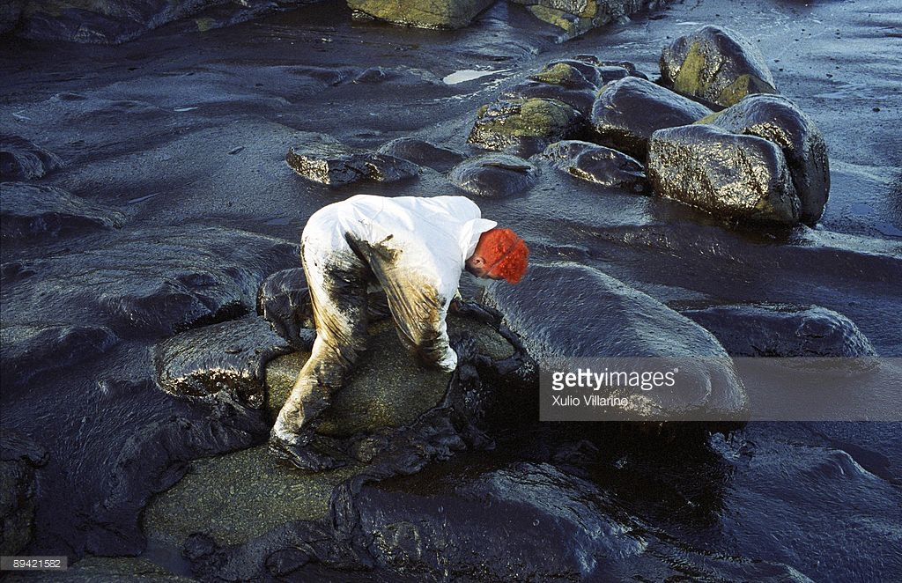

Slide 6
  Uranium Mining at Jadugoda
  https://www.youtube.com/watch?v=YggnRw7kRC4&t=6s
  Ken Saro-Wiwa and Oil Pollution in Nigeria
  https://www.youtube.com/watch?v=I9Gwf8UcgS0

Slide 7
Ecological Distribution Conflicts
  QUESTION: How do these issues connect to EQUALITY, JUSTICE and RIGHTS?

Slide 8
Ecological Distribution Conflicts
  Oil extraction: local population versus oil companies/government? WHO will talk about greenhouse emissions, and WHY?
  Conflicts over genetic resources: local communities versus companies/governments? EXAMPLE: Neem/Basmati/Turmeric.
  Sardar Sarovar dam: WHO gets electricity/water? WHO loses land?
  Water conflicts: Industrial versus community use
  Oil spills: Galicia incident
  Landfills/waste sites
  Uranium Mining
  Shrimp/Prawn farming: Local/traditional farming versus trawlers
  Control over carbon sinks
    US/UK: Most polluting countries should get to use the biggest sinks
    CSE’s suggestion: EQUAL per capita rights/use over soil/forests/atmosphere

Slide 9
Vocabularies of Conflicts
  HOW have these conflicts been framed?
  Struggles over ETHNIC (adivasi) political/cultural rights.
  Ken Saro-Wiwa.
  Territorial rights of communities/countries. Unequal economic exchange, unaccounted environmental local ‘externalities’
  Jadugoda, Galacia.
  Corporate accountability: ‘Class struggles’ against corporate greed
  Jadugoda, Bhopal Gas Tragedy.
  Environmentalism of the poor
  Protests against Copper Mining in Japan, Copper refinery versus silk industry.

Slide 10
Environmentalism of the Poor
  ALSO: Environmental Justice/Popular Environmentalism/Livelihood Ecology ...
  WHAT does this say?
  Economic growth -> Increased environmental impacts
  Economic growth -> Increased geographic displacement between environmental sources/sinks. Transnational/National/Regional
  EXAMPLES: Oil, Aluminium, Copper, Eucalyptus, Shrimp, Gold
  DISPROPORTIONATE distribution of impacts felt by SOME social groups
  Main thrust of protests: NOT protection of SACRED nature, but protection of livelihoods TODAY
  Technology is NOT the only solution

Slide 11
Environmentalism of the Poor
  Manifestations?
  Farmers as unacknowledged ‘inventors’/innovators
  Environmental ‘racism’ in the US
  Many forms of the struggles of the POOR
  Moving from NIMBY to NIABY

Slide 12
Ecological Distribution Conflicts
  Link between environmental degradation, human rights and civil rights:
  “In many places where Black, minority, poor or Indigenous people live, oil, timber and minerals are extracted in such a way as to devastate eco-systems and destroy their culture and livelihood. Waste from both high-and low-tech industries, much of it toxic, has polluted groundwater, soil, and the atmosphere. Environmental degradation such as this, and its concomitant impact on human wealth and welfare, is increasingly seen as a violation of human rights”
  Environmental ‘Racism’ hotspots in the US: Louisiana (‘Cancer Alley’ between New Orleans and Baton Rouge)
  Environmental ‘Racism’ hotspots in India: Adivasi dominated regions, urban slums…

Slide 13
'Dirty' Industries: Just between you and me, shouldn't the World Bank be encouraging MORE migration of the dirty industries to the LDCs [Least Developed Countries]? I can think of three reasons:
1) The measurements of the costs of health impairing pollution depends on the foregone earnings from increased morbidity and mortality. From this point of view a given amount of health impairing pollution should be done in the country with the lowest cost, which will be the country with the lowest wages. I think the economic logic behind dumping a load of toxic waste in the lowest wage country is impeccable and we should face up to that.
2) The costs of pollution are likely to be non-linear as the initial increments of pollution probably have very low cost. I've always thought that under-populated countries in Africa are vastly UNDER-polluted, their air quality is probably vastly inefficiently low compared to Los Angeles or Mexico City. Only the lamentable facts that so much pollution is generated by non-tradable industries (transport, electrical generation) and that the unit transport costs of solid waste are so high prevent world welfare enhancing trade in air pollution and waste.

Slide 14
3) The demand for a clean environment for aesthetic and health reasons is likely to have very high income elasticity. The concern over an agent that causes a one in a million change in the odds of prostrate[sic] cancer is obviously going to be much higher in a country where people survive to get prostrate[sic] cancer than in a country where under 5 mortality is 200 per thousand. Also, much of the concern over industrial atmosphere discharge is about visibility impairing particulates. These discharges may have very little direct health impact. Clearly trade in goods that embody aesthetic pollution concerns could be welfare enhancing. While production is mobile the consumption of pretty air is a non-tradable.
The problem with the arguments against all of these proposals for more pollution in LDCs (intrinsic rights to certain goods, moral reasons, social concerns, lack of adequate markets, etc.) could be turned around and used more or less effectively against every Bank proposal for liberalization.
— Lawrence Summers

Slide 15
Reasons for siting preferences?
  ECONOMIC explanations:
    Need to maximise profits, Reduce costs
    -> Cheapest land, labour -> poor areas (Mississippi River)
    Industrial pollution -> Migration of the rich
    Industrial pollution -> Cheaper land/housing -> More poor people
  SOCIO-POLITICAL explanations:
    Least political resistance
    NIMBY syndrome (favouring people with social capital)
  RACIAL explanations:
    Racial prejudices
    Past discrimination. Zoning discrimination -> Siting discrimination
    Cultural narratives of ‘polluted’/unclean people
INTERELATED explanations? TRANSNATIONAL racism?

Slide 16
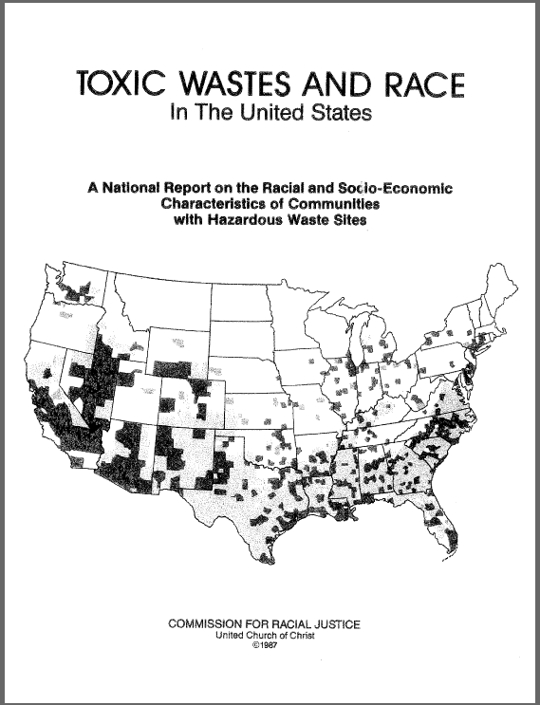
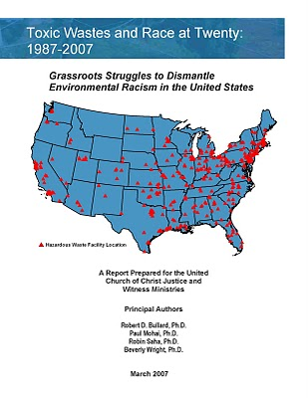

Slide 17
Environmental Racism
    Toxic Wastes and Race report: Race is the most important factor deciding location of toxic waste facilities.
    “..Average % of people of colour in zip codes containing at least one ...waste facility was double that of zip code areas containing none, and where 2 or more facilities were located, the average % was triple”
    1982: FIRST use of the term ‘environmental racism’.
      Discriminatory environmental policy (making/enforcement)
      Official sanction of pollutants near Black communities
      Absence of Black leadership in environmental movements
      ‘Environment’ is about the way we live, and ‘Justice’ has to include ALL aspects
    Demands/Issues?
      Local/National/Global interventions
      Relocation of affected communities?
      Higher workspace standards and globalisation

Slide 18
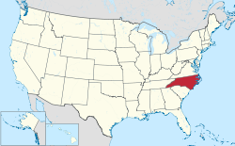
Emerging shades of Environmentalism
  From NIMBY to Civil Rights
  Warren County movement against toxic waste disposal and its implications
    Background: Classic story of corporate irresponsibility -> ecological impacts.
    SHIFTING trajectories of protest:
    From threats to groundwater and local economy – ‘Environmental racism’
“The community was politically and economically unempowered; that was the reason for the siting. They took advantage of poor people and people of colour”

Slide 19
Emerging shades of Environmentalism
  ‘BIRTH’ of the ‘ENVIRONMENTAL JUSTICE’ movement
  HOW did environmental rights and civil rights join forces?
  Battling the narrative that the environmentalism = Elitism/Racism/Exclusion
  1968-1975: OLD narrative worked. Hesitation on BOTH sides.
    Environmental leadership: White, professional, middle-class, male. 58% of Sierra Club said it should NOT address concerns of ethnic minorities/urban poor
    Environmentalism as a “segregated bus” for Blacks?
    “I don’t give a good goddamn about ecology...the nation’s concern with environment...distracts the nation from HUMAN problems of black and brown Americans”
    Sharp divide between environmental problems of the TWO groups
    BUT, young Blacks thought pollution was AS important as poverty/desegregation.

Slide 20
Emerging shades of Environmentalism
  1978-1983: NEW narrative of ‘Environmental Justice’
    White activists sought to expand their base
    Civil Rights movement sought to expand their issues
    Possible sites for waste disposal? Afton (Warren County) OR Emelle (Alabama)
    First response: NIMBY. Memories of Love Canal (1978, New York). So where? Alabama?
    Loss of local decision-making control -> Coalition building
    Building coalitions, involvement of NAACP
    Toxics and Race report
    Environmental Racism: NOT in African-American Backyards , Blacks as ‘guinea pigs’ discourse
    Role of ‘Big’ groups (Sierra Club/Conservation Council of North Carolina)?

